Slide 1
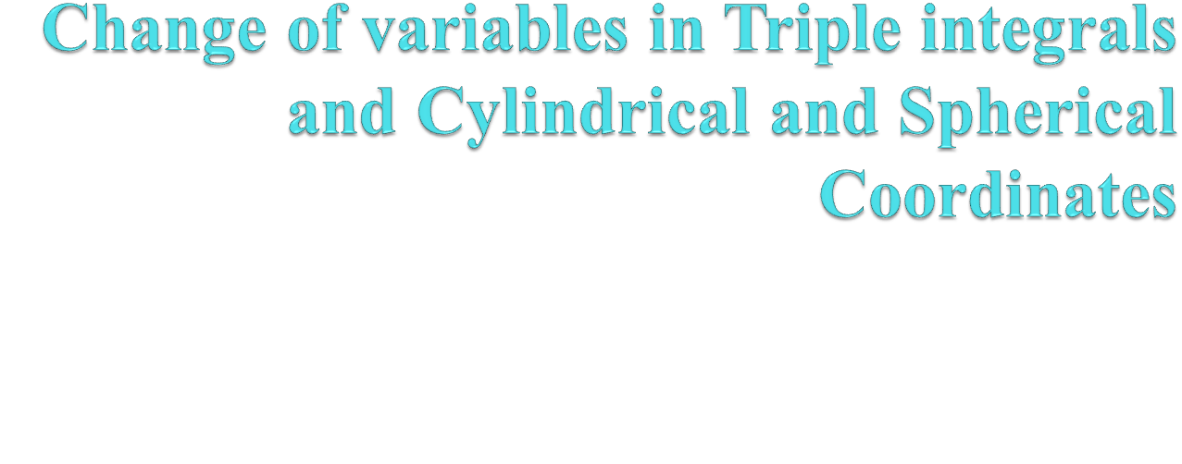

Slide 2

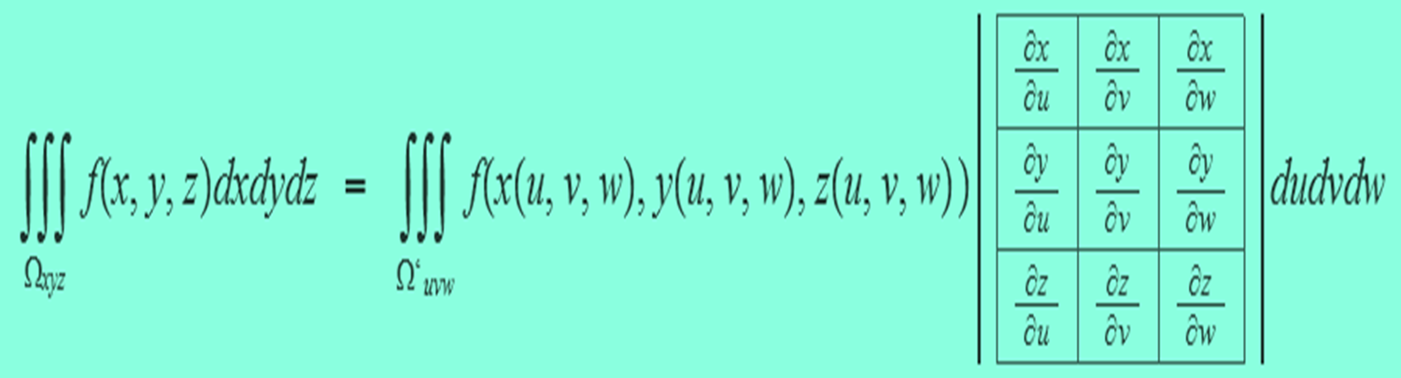

Slide 3
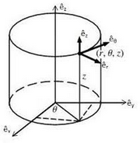
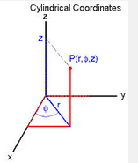
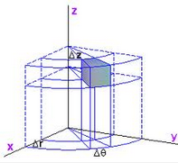

Slide 4



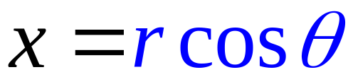

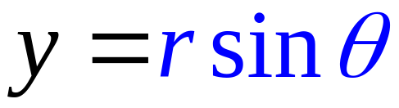




Cylindrical Coordinates
＝ polar
＋ z-coordinate
Cylindrical Coordinates

Slide 5
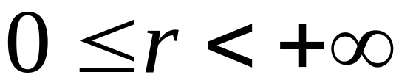
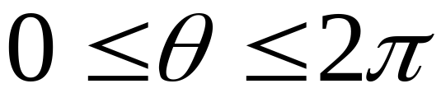
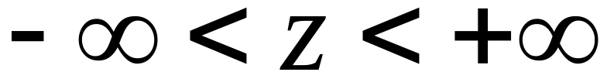
define：

Slide 6
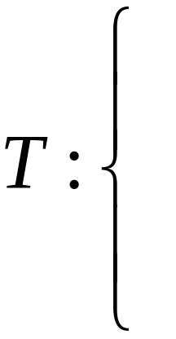
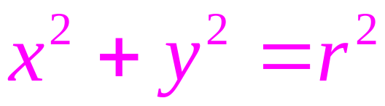
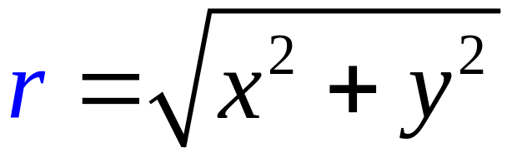
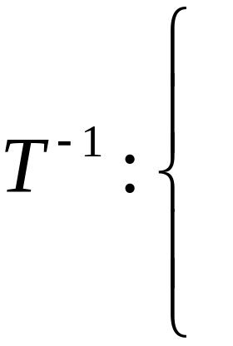
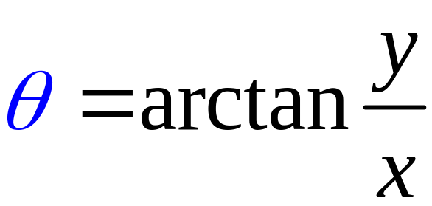


Slide 7
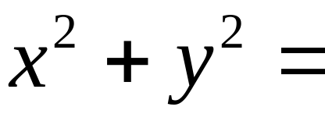

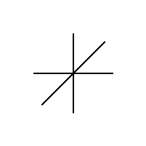

Coordinate surfaces
constant
cylinder：
constant
So, it is called cylindrical coordinates

Slide 8
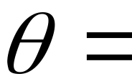
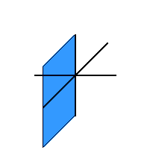
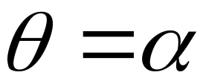

constant
Half plane

Slide 9
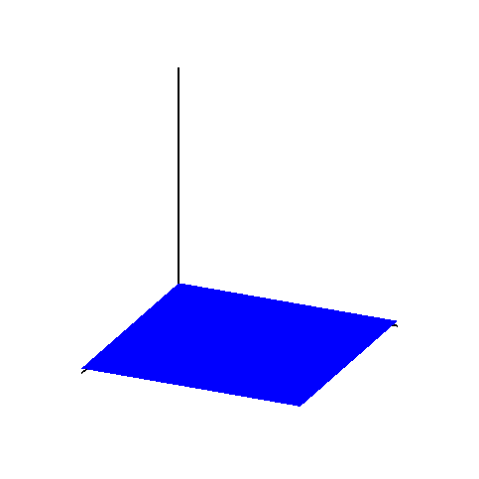

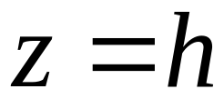

constant
plane
with(plots):
x_axis:=plot3d([u,0,0],u=0..2,v=0..0.01,thickness=2):
y_axis:=plot3d([0,u,0],u=0..2,v=0..0.01,thickness=2):
z_axis:=plot3d([0,0,u],u=0..11,v=0..0.01,thickness=2):
for i from 1 to 40 do
pingmian[i]:=plot3d([t,s,i/4],t=0..2,s=0..2,color=blue,style=patchnogrid):
od:
pingmian:=display(seq(pingmian[i],i=1..40),insequence=true):
display(pingmian,x_axis,y_axis, z_axis,orientation=[24,67]);

Slide 10
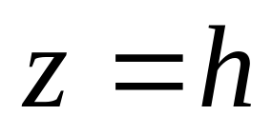

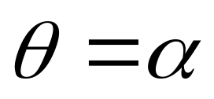
Coordinate plane/surfaces

Slide 11
run in Maple
with(plots):
x_axis:=plot3d([u,0,0],u=0..2,v=0..0.01,thickness=2):
y_axis:=plot3d([0,u,0],u=0..2,v=0..0.01,thickness=2):
z_axis:=plot3d([0,0,u],u=0..2.3,v=0..0.01,thickness=2):
for i from 1 to 40 do
zhumian[i]:=plot3d([2*i/40,theta,z],theta=0..2*Pi,z=0..2,color=green,style=patch,coords=cylindrical):
pingmian[i]:=plot3d([x,y,2*i/40],x=-2..2,y=-2..2,color=blue,style=patchnogrid):
banpingmian[i]:=plot3d([r,2*Pi*i/40,z],r=0..3,z=0..2,color=brown,style=patchnogrid,coords=cylindrical):
od:
banpingmian:=display(seq(banpingmian[i],i=1..40),insequence=true):
pingmian:=display(seq(pingmian[i],i=1..40),insequence=true):
zhumian:=display(seq(zhumian[i],i=1..40),insequence=true):
display(pingmian,banpingmian,zhumian,x_axis,y_axis, z_axis,orientation=[24,67]);

Slide 12











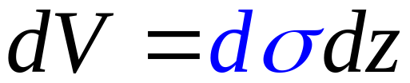
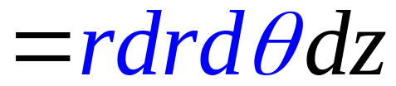
Finding the volume element
Delta r, theta, and z

Slide 13
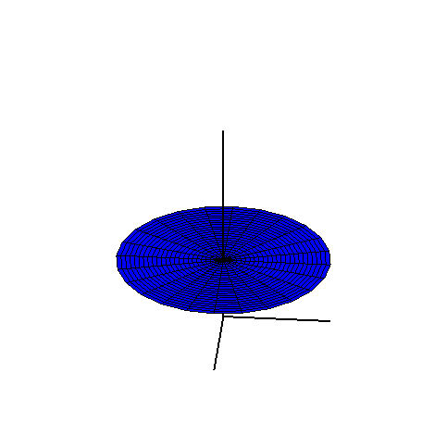
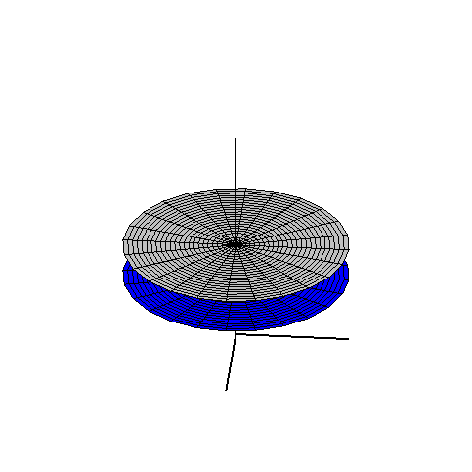
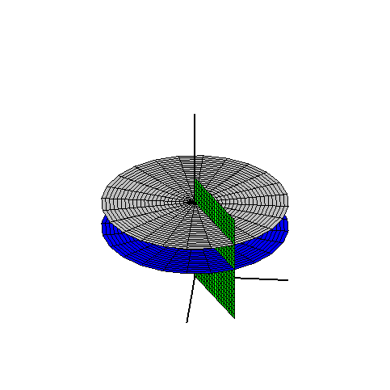
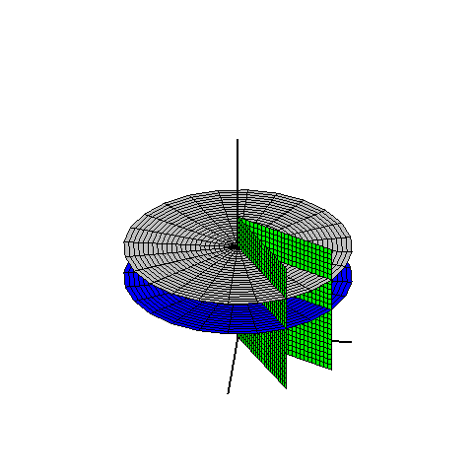
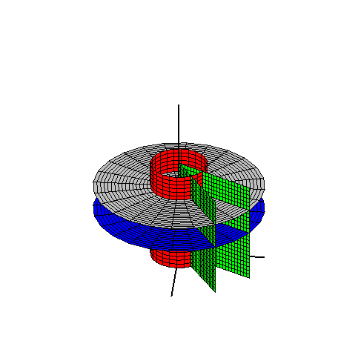
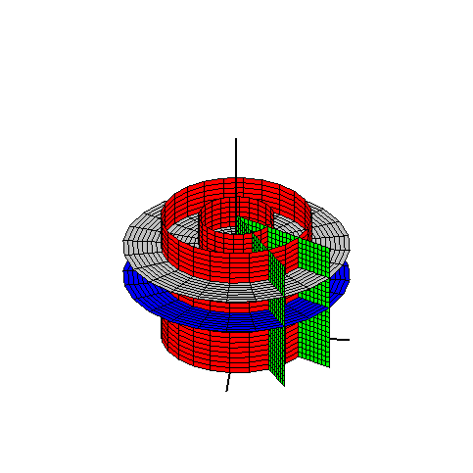
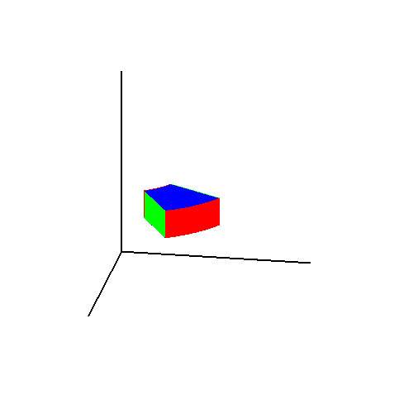
with(plots):x_axis:=plot3d([u,0,0],u=0..3,v=0..0.01,thickness=2):
y_axis:=plot3d([0,u,0],u=0..3,v=0..0.01,thickness=2):
z_axis:=plot3d([0,0,u],u=0..3.3,v=0..0.01,thickness=2):
banpingmian1:=plot3d([r,Pi/6,z],r=0..3,z=0..2,coords=cylindrical,style=patch,color=green):
banpingmian2:=plot3d([r,Pi/3,z],r=0..3,z=0..2,coords=cylindrical,style=patch,color=green):
zhumian1:=plot3d([1,theta,z],theta=0..2*Pi,z=0..2,coords=cylindrical,style=patch,color=red):
zhumian2:=plot3d([2,theta,z],theta=0..2*Pi,z=0..2,coords=cylindrical,style=patch,color=red):
pingmian1:=plot3d([r,theta,1],r=0..3,theta=0..2*Pi,coords=cylindrical,style=patch,color=blue):
pingmian2:=plot3d([r,theta,1.5],r=0..3,theta=0..2*Pi,coords=cylindrical,style=patch,color=grey):
display(pingmian1,pingmian2,banpingmian1,banpingmian2,zhumian1,zhumian2,x_axis,y_axis,z_axis,orientation=[5,60]);

Slide 14
with(plots):x_axis:=plot3d([u,0,0],u=0..3,v=0..0.01,thickness=2):
y_axis:=plot3d([0,u,0],u=0..3,v=0..0.01,thickness=2):
z_axis:=plot3d([0,0,u],u=0..3.3,v=0..0.01,thickness=2):
banpingmian1:=plot3d([r,Pi/6,z],r=1..2,z=1..1.5,coords=cylindrical,style=patchnogrid,color=green): banpingmian2:=plot3d([r,Pi/3,z],r=1..2,z=1..1.5,coords=cylindrical,style=patchnogrid,color=green):
zhumian1:=plot3d([1,theta,z],theta=Pi/6..Pi/3,z=1..1.5,coords=cylindrical,style=patchnogrid,color=red):
zhumian2:=plot3d([2,theta,z],theta=Pi/6..Pi/3,z=1..1.5,coords=cylindrical,style=patchnogrid,color=red):
pingmian1:=plot3d([r,theta,1],r=1..2,theta=Pi/6..Pi/3,coords=cylindrical,style=patchnogrid,color=blue):
pingmian2:=plot3d([r,theta,1.5],r=1..2,theta=Pi/6..Pi/3,coords=cylindrical,style=patchnogrid,color=blue):
display(banpingmian1,banpingmian2,zhumian1,zhumian2,pingmian1,pingmian2,x_axis,y_axis,z_axis,orientation=[10,70]);

Slide 15
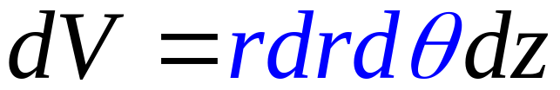


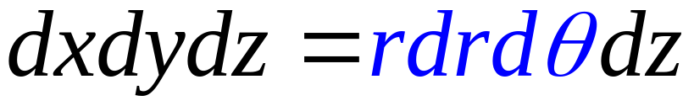
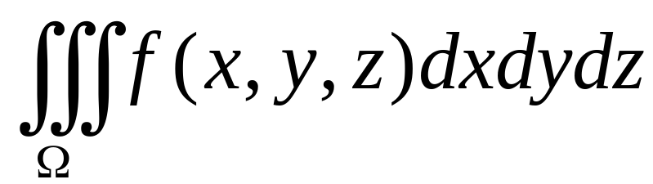
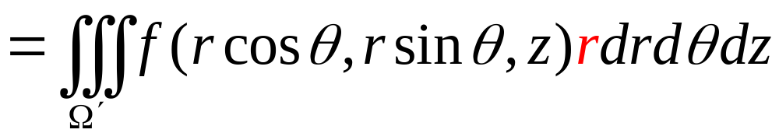

Slide 16
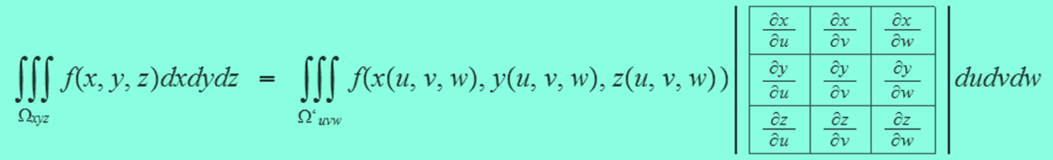
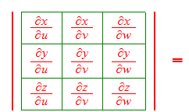
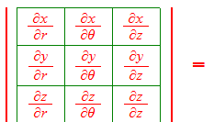
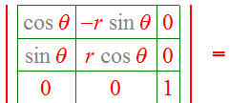
Also

Slide 17
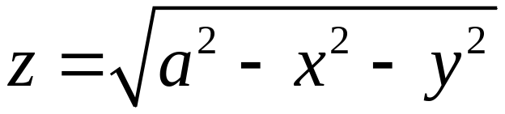
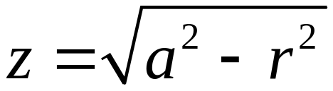
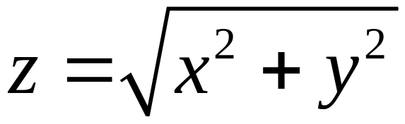

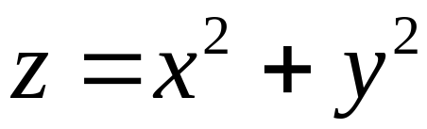
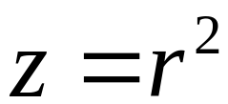
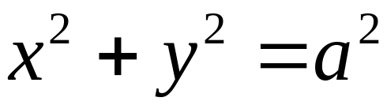

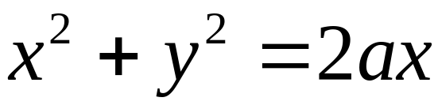

常见曲面的柱面坐标方程
直角坐标方程
柱面坐标方程
半球面
圆锥面
旋转抛物面
圆柱面
圆柱面

Slide 18
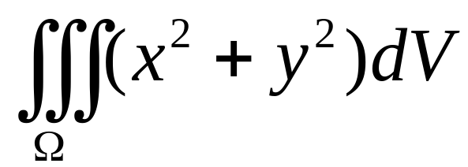
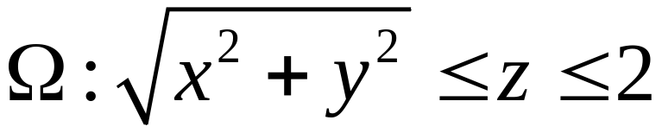




Example
is a cone
The projection is a disk
Use cylindrical coordinates

Slide 19











Slide 20



Example Find the volume of the solid bounded by
Cylinder (projection line)
The region

Slide 21

with(plots):
zuimian:=implicitplot3d(z=sqrt(x^2+y^2),x=-2..2,y=-2..2,z=0..1.6,color=black,grid=[20,20,20]):
paowumian:=implicitplot3d(z=x^2+y^2,x=-2..2,y=-2..2,z=0..1.8,color=red,grid=[20,20,20]):
x_axis:=plot3d([u,0,0],u=-1.2..1.2,v=0..0.01,thickness=2):
y_axis:=plot3d([0,u,0],u=-1.2..1.2,v=0..0.01,thickness=2):
z_axis:=plot3d([0,0,u],u=-0.2..2,v=0..0.01,thickness=2):
display(zuimian,paowumian,x_axis,y_axis, z_axis,orientation=[23,66],scaling=constrained);

Slide 22





7.4 三重积分（柱、球）

Slide 23











Cross section of
Upper boundary：
Lower boundary：

Slide 24








Evaluate
Projection region on the plane xOy

Slide 25





Lower boundary：
cone
Upper boundary：
sphere

Slide 26





Slide 27







Spherical coordinates
Spherical coordinates

Slide 28













Slide 29


constant
sphere：
constant

Slide 30
constant
Half plane

Slide 31






constant
cone：

Slide 32
Spherical coordinates

Slide 33


Converting Cartesian to Spherical
Find a spherical coordinate equation for the sphere
Find a spherical coordinate equation for the cone

Slide 34
animation
run in Maple
with(plots):
x_axis:=plot3d([u,0,0],u=0..3,v=0..0.01,thickness=2):
y_axis:=plot3d([0,u,0],u=0..3,v=0..0.01,thickness=2):
z_axis:=plot3d([0,0,u],u=0..3.3,v=0..0.01,thickness=2):
for i from 0 to 40 do
zuimian[i]:=plot3d([r,theta,Pi*i/40],r=0..3,theta=0..2*Pi,color=green,style=patch,coords=spherical):
qiumian[i]:=plot3d([2*i/40,theta,phi],theta=0..2*Pi,phi=0..Pi,style=patch,coords=spherical):
banpingmian[i]:=plot3d([r,2*Pi*i/40,z],r=0..3,z=-3..3,color=brown,style=patchnogrid,coords=cylindrical):
od:
banpingmian:=display(seq(banpingmian[i],i=1..40),insequence=true):
qiumian:=display(seq(qiumian[i],i=1..40),insequence=true):
zuimian:=display(seq(zuimian[i],i=1..40),insequence=true):
display(qiumian,banpingmian,zuimian,x_axis,y_axis, z_axis,orientation=[24,67],scaling=constrained);

Slide 35






with(plots):
x_axis:=plot3d([u,0,0],u=0..3,v=0..0.01,thickness=2):
y_axis:=plot3d([0,u,0],u=0..3,v=0..0.01,thickness=2):
z_axis:=plot3d([0,0,u],u=0..3.3,v=0..0.01,thickness=2):
banpingmian1:=plot3d([r,Pi/4,z],r=0..3,z=0..2,coords=cylindrical,style=patch,color=green):
banpingmian2:=plot3d([r,Pi/2.5,z],r=0..3,z=0..2,coords=cylindrical,style=patch,color=grey):
zuimian1:=plot3d([r,theta,Pi/4],theta=0..2*Pi,r=0..2,coords=spherical,style=patch,color=red):
zuimian2:=plot3d([r,theta,Pi/3],theta=0..2*Pi,r=0..3,coords=spherical,style=patch,color=yellow):
qiumian1:=plot3d([1,theta,phi],phi=0..Pi,theta=0..2*Pi,coords=spherical,style=patch,color=brown):
qiumian2:=plot3d([1.5,theta,phi],phi=0..Pi,theta=0..2*Pi,coords=spherical,style=patch,color=grey):
display(banpingmian1,banpingmian2,zuimian1,zuimian2,qiumian2,x_axis,y_axis,z_axis,orientation=[5,60]);

Slide 36

with(plots):
x_axis:=plot3d([u,0,0],u=0..1.5,v=0..0.01,thickness=2):
y_axis:=plot3d([0,u,0],u=0..1.5,v=0..0.01,thickness=2):
z_axis:=plot3d([0,0,u],u=0..1.5,v=0..0.01,thickness=2):
banpingmian1:=plot3d([r,Pi/5,phi],r=1..1.5,phi=Pi/5..Pi/3,coords=spherical,style=patch,color=green):
banpingmian2:=plot3d([r,Pi/3,phi],r=1..1.5,phi=Pi/5..Pi/3,coords=spherical,style=patch,color=green):
zuimian1:=plot3d([r,theta,Pi/5],theta=Pi/5..Pi/3,r=1..1.5,coords=spherical,style=patch,color=yellow):
zuimian2:=plot3d([r,theta,Pi/3],theta=Pi/5..Pi/3,r=1..1.5,coords=spherical,style=patch,color=yellow):
qiumian1:=plot3d([1,theta,phi],phi=Pi/5..Pi/3,theta=Pi/5..Pi/3,coords=spherical,style=patch,color=red):
qiumian2:=plot3d([1.5,theta,phi],phi=Pi/5..Pi/3,theta=Pi/5..Pi/3,coords=spherical,style=patch,color=red):
display(banpingmian1,banpingmian2,zuimian1,zuimian2,qiumian1,qiumian2,x_axis,y_axis,z_axis,orientation=[5,74]);

Slide 37













with(plots):
x_axis:=plot3d([u,0,0],u=0..1.5,v=0..0.01,thickness=2):
y_axis:=plot3d([0,u,0],u=0..1.5,v=0..0.01,thickness=2):
z_axis:=plot3d([0,0,u],u=0..1.5,v=0..0.01,thickness=2):
banpingmian1:=plot3d([r,Pi/5,phi],r=1..1.5,phi=Pi/5..Pi/3,coords=spherical,style=patch,color=green):
banpingmian3:=plot3d([r,Pi/5,phi],r=0..1.6,phi=Pi/7..Pi/2.5,coords=spherical,style=wireframe,color=green):
banpingmian2:=plot3d([r,Pi/3,phi],r=1..1.5,phi=Pi/5..Pi/3,coords=spherical,style=patch,color=grey):
banpingmian4:=plot3d([r,Pi/3,phi],r=0..1.6,phi=Pi/7..Pi/2.5,coords=spherical,style=wireframe,color=green):
zuimian1:=plot3d([r,theta,Pi/5],theta=Pi/5..Pi/3,r=1..1.5,coords=spherical,style=patch,color=yellow):
zuimian3:=plot3d([r,theta,Pi/5],theta=Pi/7..Pi/2.5,r=0..1.8,coords=spherical,style=wireframe,color=blue):
zuimian2:=plot3d([r,theta,Pi/3],theta=Pi/5..Pi/3,r=1..1.5,coords=spherical,style=patch,color=yellow):
zuimian4:=plot3d([r,theta,Pi/3],theta=Pi/7..Pi/2.5,r=0..1.8,coords=spherical,style=wireframe,color=blue):
qiumian1:=plot3d([1,theta,phi],phi=Pi/5..Pi/3,theta=Pi/5..Pi/3,coords=spherical,style=patch,color=red):
qiumian3:=plot3d([1,theta,phi],phi=Pi/7..Pi/2.5,theta=Pi/7..Pi/2.5,coords=spherical,style=wireframe,color=red):
qiumian2:=plot3d([1.5,theta,phi],phi=Pi/5..Pi/3,theta=Pi/5..Pi/3,coords=spherical,style=patch,color=red):
qiumian4:=plot3d([1.5,theta,phi],phi=Pi/7..Pi/2.5,theta=Pi/7..Pi/2.5,coords=spherical,style=wireframe,color=red):
display(banpingmian1,banpingmian2,zuimian1,zuimian2,qiumian1,qiumian2,banpingmian3,banpingmian4,zuimian3,zuimian4,qiumian3,qiumian4,x_axis,y_axis,z_axis,orientation=[5,74]);

Slide 38












Volume Element
Delta r
Delta Phi
Delta theta
Volume element

Slide 39


Volume element

Slide 40



Change from rectangular to spherical coordinates

Slide 41

Alternatively

Slide 42










Example
Solution
so

Slide 43


Example Find the volume of the solid bounded by

Slide 44





with(plots):
zuimian:=plot3d([r*cos(t),r*sin(t),r],t=0..2*Pi,r=0..1,color=yellow):
qiumian:=plot3d([sin(s)*cos(t),sin(s)*sin(t),cos(s)+1],s=0..Pi/2,t=0..2*Pi,color=green):
x_axis:=plot3d([u,0,0],u=-1..1,v=0..0.01,thickness=2):
y_axis:=plot3d([0,u,0],u=-1..1,v=0..0.01,thickness=2):
z_axis:=plot3d([0,0,u],u=0..1,v=0..0.01,thickness=2):
display(qiumian,zuimian,x_axis,y_axis, z_axis,orientation=[20,70],scaling=constrained);

Slide 45








Slide 46






Slide 47




Example
cone
解
在 xOy 面上的投影区域
为圆域：

Slide 48










直角坐标

Slide 49





柱面坐标

Slide 50









球面坐标

Slide 51
比较：
似乎柱面坐标最简单

Slide 52
END

